Slide 1

Anti-blind Glasses based on Optogenetics
Xin Jin

Slide 2
Theory. context
Why does blindness interest me
It's mainly beacuse one of my relatives is a blind, and I found he was totally different from able-bodied people mentally
and physically. And also because he lost abilities of working and living independently, he is discriminated against.
Another reason is that I have an interest in designing smart product to help people, and the blind as a group in need is a good target.
Which fields did I explore
Then I decided the topic of my concept ( bring the brightness back to the blind ), and explore the relative fields, scuh as the current situation of the blind, treatment of blindness and social exclusion of the blind.

Slide 3
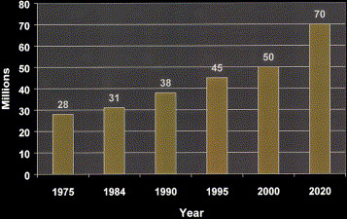
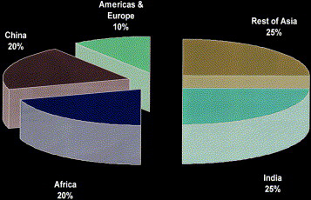
Theory. findings
Blindness in the world
1. There is considerable and increasing blind people worldwide. The recent data from the World Health Organization (WHO) estimates around 50 million blind people worldwide in 2000, and it increases by 1 million people every year.
2. The lack of eye care services contribute significantly to the growing number of blind people, especially cataract-blind.
Fig. 1. Global blindness (millions), 1975 projected to 2020.
Fig. 2 Distribution of total global blindness according to regions
Strategies for curing blindness
Social exclusion of the blind
1. There are 3 possible ways to cure blindness, respectively electronic retinal implants, optogenetics and chemical neural interfaces.
2. electronic retinal implants need to implant electronic chip into eyes which can not be replaced and possibly cause rejection and infection. And chemical neural interfaces remains theory and patients need frequent injections over a time span of decades.
1. Blind people often feel underlying stress in social relationship and disconnected from others, because they realize they are different from able-bodied people. Blind people like to share their stories as the blind with others to release their pressure, but most of them do not have a chance.
2. Some people show overt hostility to the blind, such as hate crime, but most of people show subtle exclusion, like approving non-disabled policy.

Slide 4
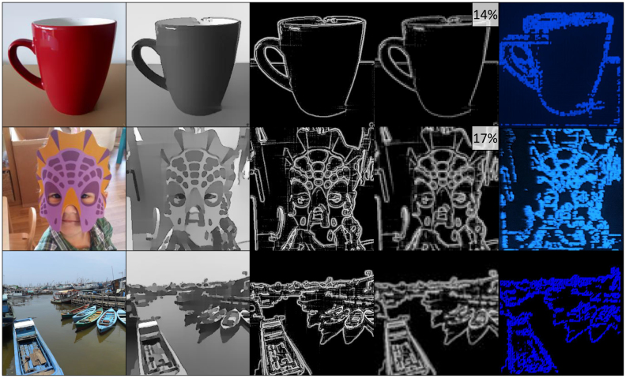
Theory. technological basement
What is Optogenetics
Optogenetics is a biological technique to use light to control cells in living creatures. For curing blindness, it means using genetic technology to turn ordinary cells into light-sensitive cells on retina, and then using light to stimulate cells to restore eyesight.
Limitations
1. single color
2. low vision
3. strong light which may harm cells
Expectations
In the near future, blind people can see more detailed and colorful images of reality with the help of Optogenetics, not just outlines with single color.
Fig. 1. Image processing flow of Optogenetics

Slide 5
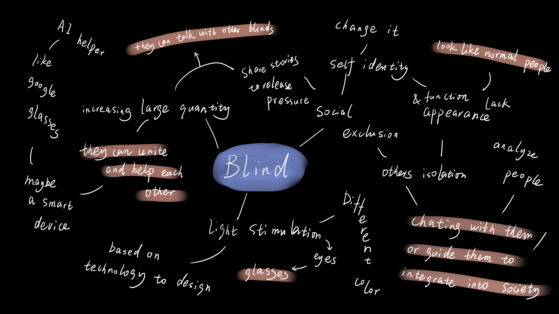
Research. Design opportunities

Slide 6
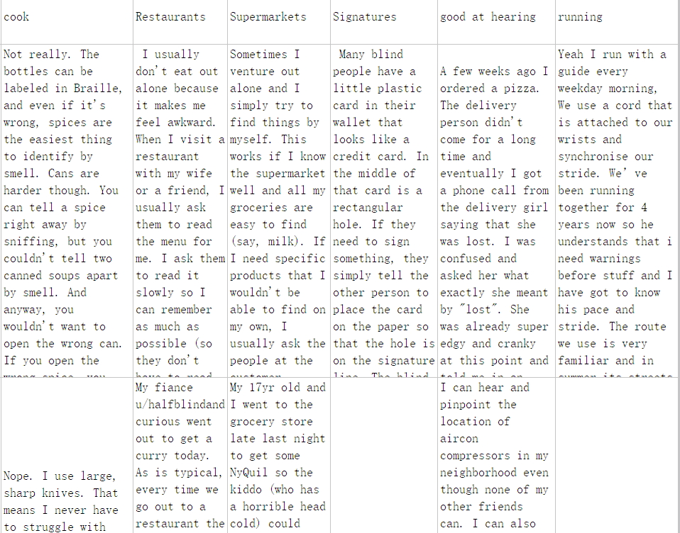
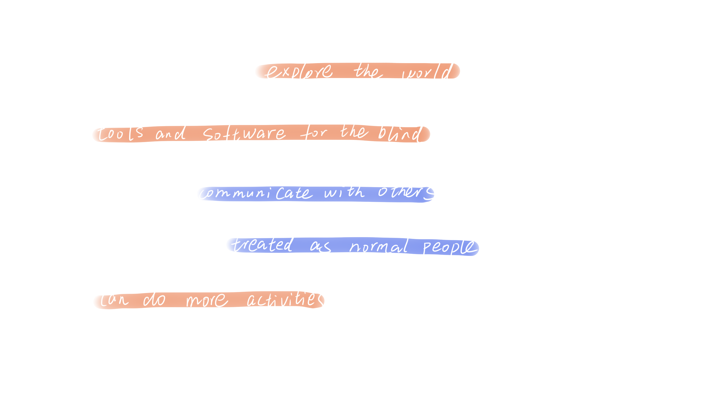
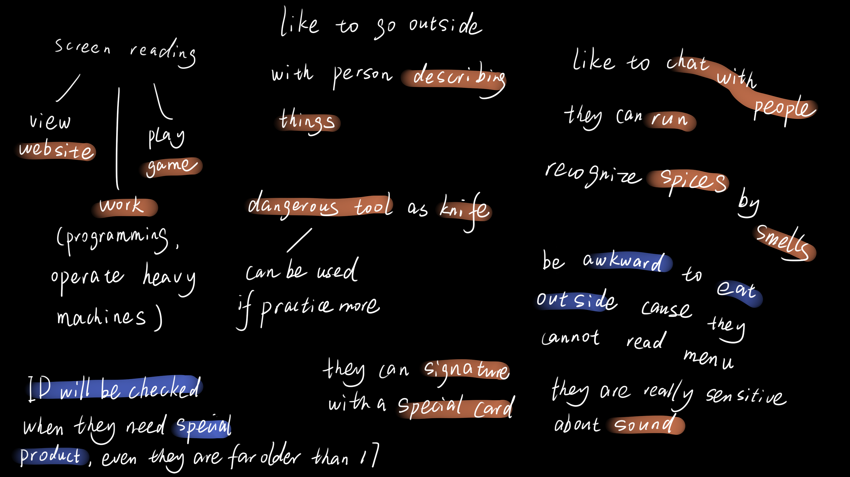
Research. user research
For learning more about the blind, I found a blind community on Reddit, and got some inspirational posts and coded them
User Demands
Fig. 1. tables of posts ( classified by different topics)
Fig. 2. keynotes
Fig. 2. codes

Slide 7
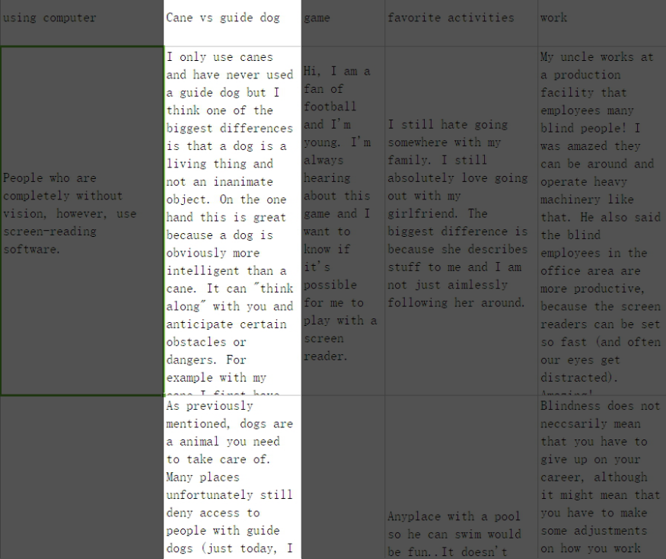
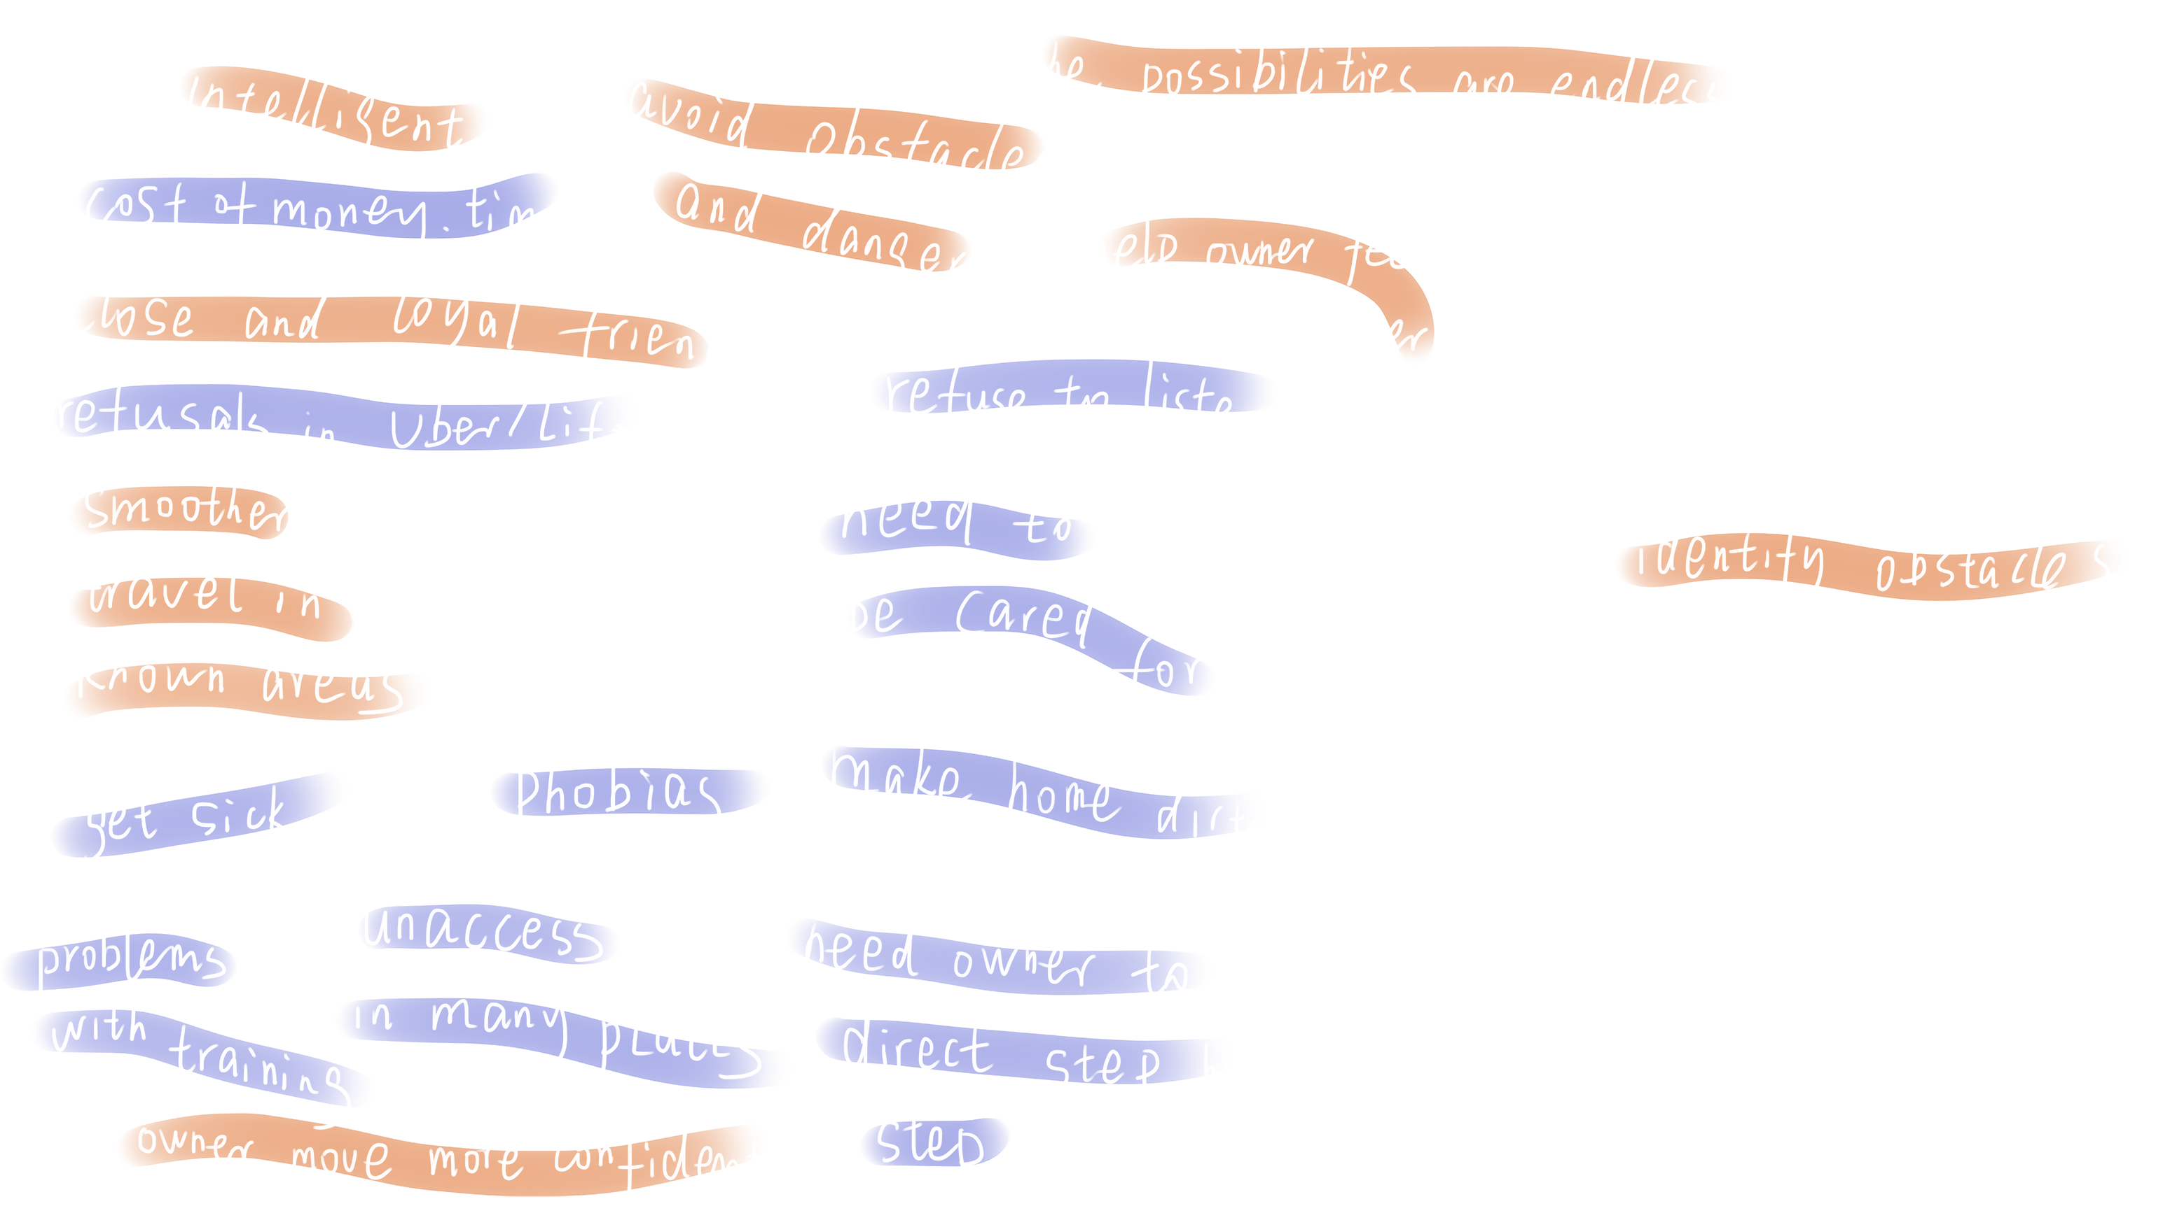
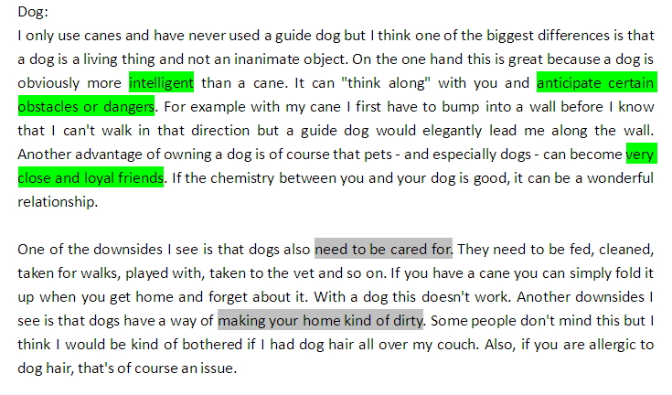
Research. user research
Cane vs guide dog
In all topics of posts, I realized the topic about cane vs guide dog helpful for my design, and analyzed the advantages and downsides of dog and cane.
Then I found that only one advantage about cane is mentioned in posts, and downsides of dog are as many as its advantages.
Fig. 1. tables of posts ( classified by different topics)
Fig. 2. keynotes
Fig. 2. codes

Slide 8
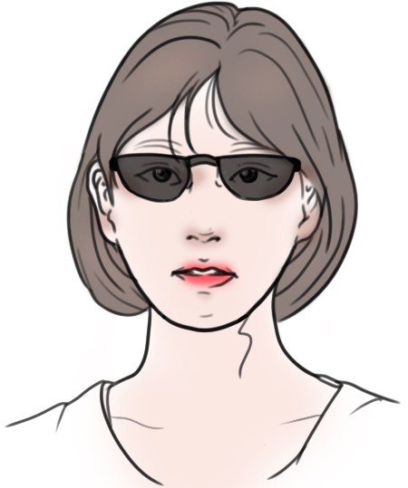

Research. user research
User Persona
User Scenario
Name: Amelia
Age: 25
Occupation: Programmer
Location: Edinburgh
Hobby:
1. running
2. cooking
3. listenning to audio books
4. wandering around with guide dog
Goal:
1. make friends with able-bodied people
2. take a flight to a strange city with her guide dog
3. teach other blind people braille
Frustration:
1. cashier always check her ID when she buy champagne
2. cannot dress up herself
3. cannot order dishes herself

Slide 9
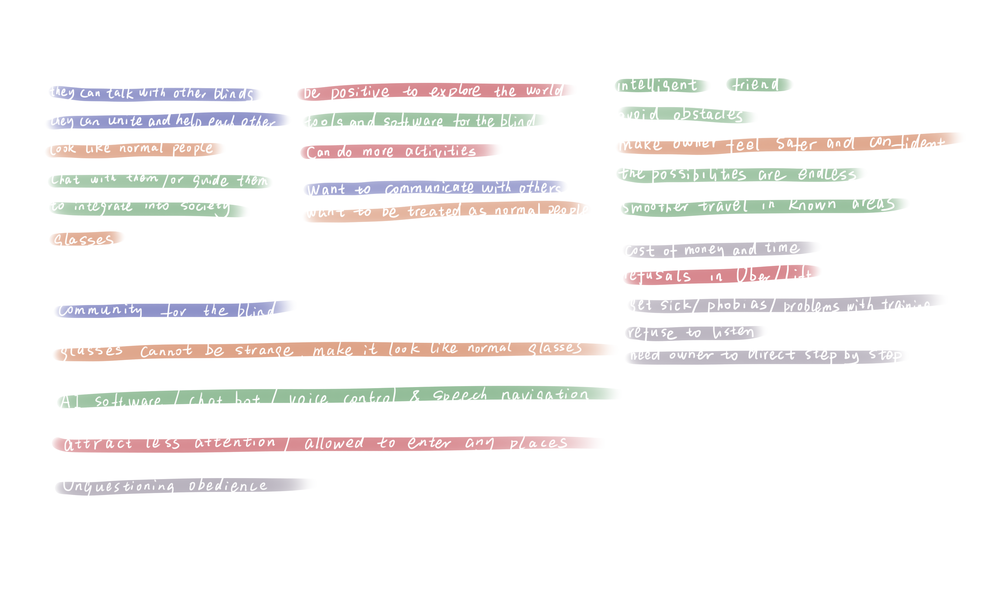
Research. Initial idea
Refine Ideas
For ensuring helpful functionality for the blind , I found similarities between design opportunities and user research, and summarized five keynotes.
First one is to establish a community for the blind. The second one is that the appearance of glasses shouldn't be strange. And the third one is that it needs an AI assistant with voice control. Next one is that it should attract less attention, and the final one is that it should show unquestioning obedience.

Slide 10

Research. Initial idea
Sketch

Slide 11
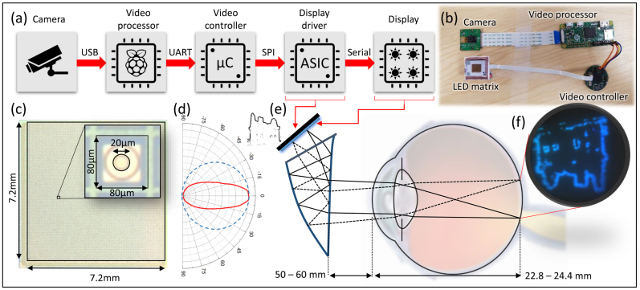
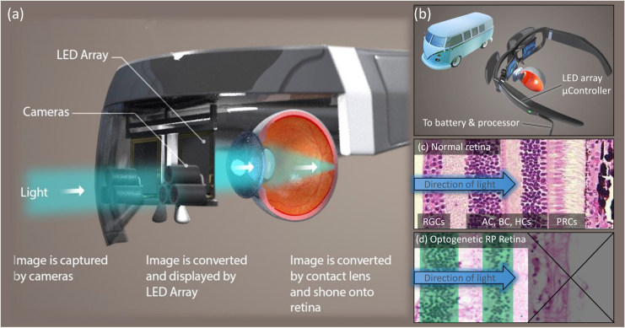
Research. improvement
Case Study
Fig. 1. Hardware flow diagram of the proposed system
Fig. 2. A concept diagram of how a headset could be constructed to provide optogenetic forms of retinal prosthesis
For grounding my design, I searched reference cases and found the paper named《A head mounted device stimulator for optogenetic retinal prosthesis》. It shows a conceptual system built in a headset and researchers tested it successfully on artificial eyes.
The process of this system is easy to understand. Initially, cameras fixed on the headset can catch the visual scene and transmit video to video processor. Next, video processor capture images from video and transmit them to video controller and display driver. And then, they simplify the images and turn them into single-color pixel matrix. Finally, LED matrix display the information by using light to stimulate light-sensitive cells on eyes, and the blind restore low vision.

Slide 12

Research. Final prototype
Concept
Anti-blind glasses have 3 groups of functions, respectively blind community, visual aid and integration aid.
Glasses can detect other users nearby by WiFi, and users can call them directly. It helps users build a close relationship so that they can unite and help each other.
Visual aid has a basic function which can restore low vision for the blind with outlines in colors. In addition, describing scenes with voice can help the blind know the details of objects, and analyzing emotions can help them to know micro-expressions on others' face.
Integration aid sets a system to encourage users to build relationships with others. If the user can get the most rewarded points in a year, he will get a donation of cornea or eyes to cure blindness completly.

Slide 13

Research. Final prototype

Slide 14
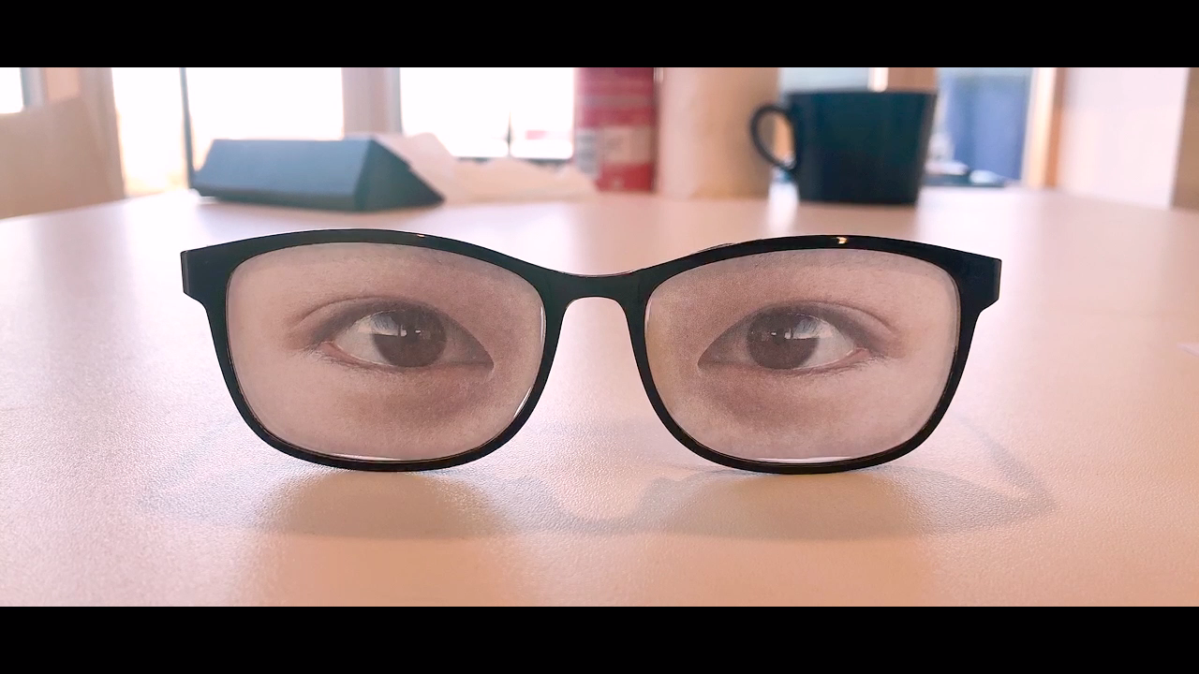
Research. Final prototype
Video

